Slide 1
DHT11 Temperature and Humidity Sensor
Group 4 - Josiah Ritchie

Slide 2
The DHT 11 sensor detects temperature and relative humidity using:
A Negative Temperature Coefficient thermistor, where the resistance of the sensor material decreases with temperature
A Humidity sensor that measures the amount of water in the air between two electrodes based on electrical resistance

Slide 3
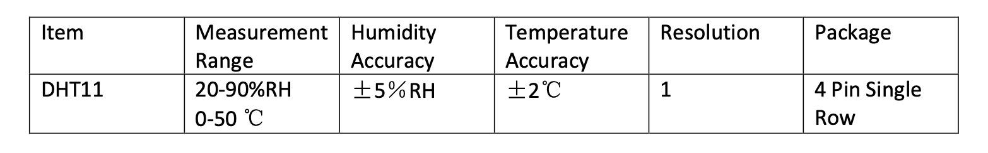
Overview:

Slide 4
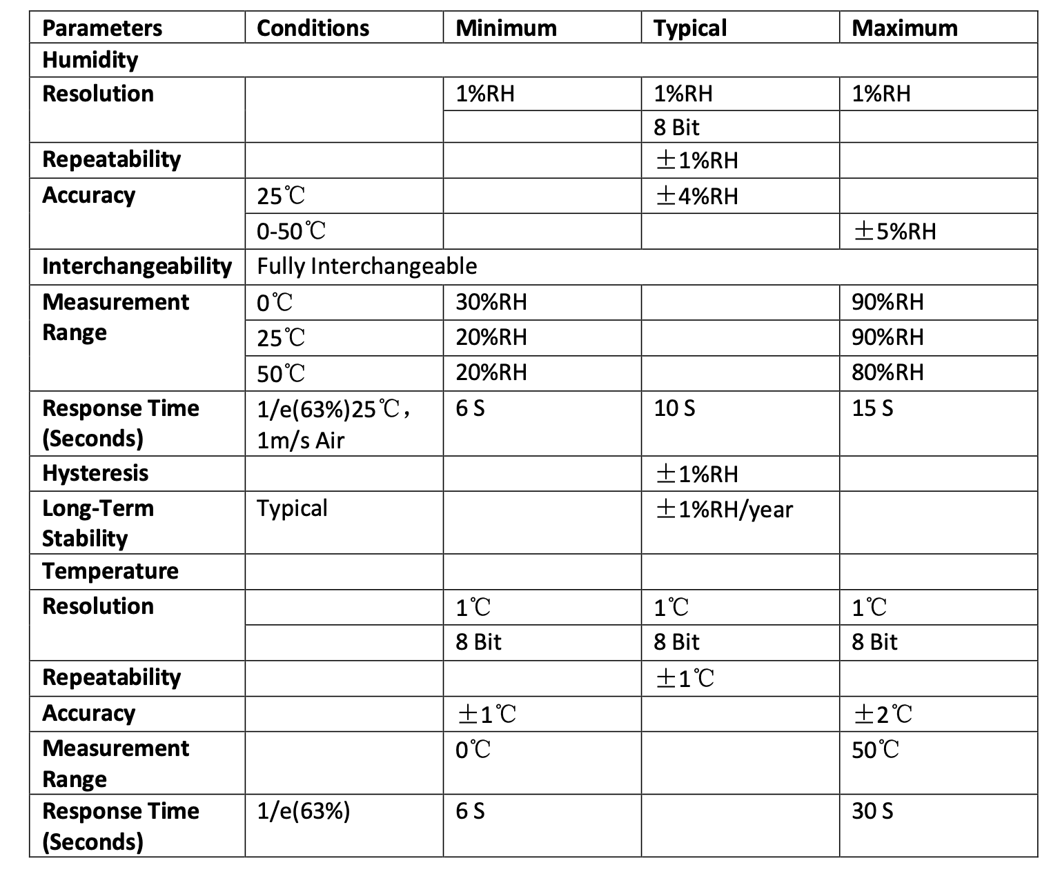
Important Characteristics of DHT11

Slide 5
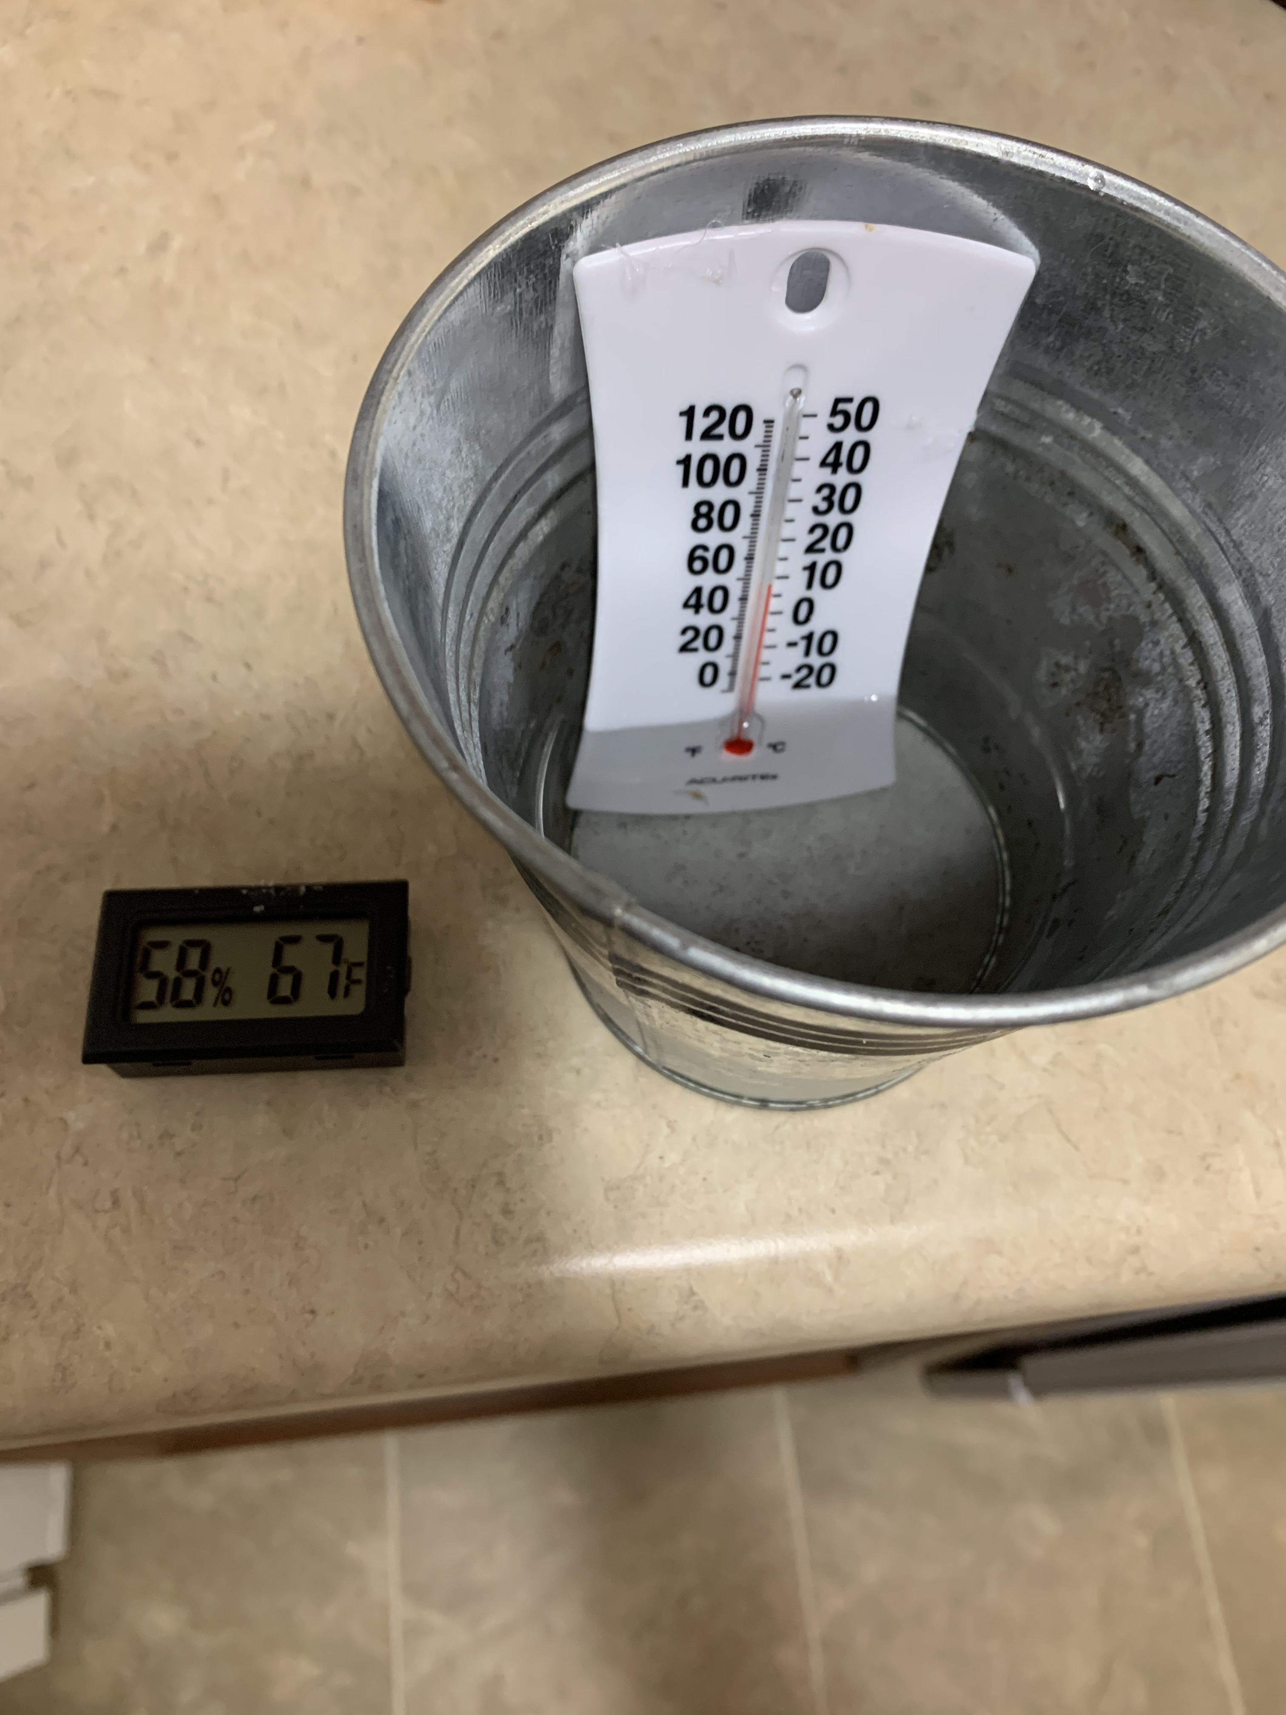
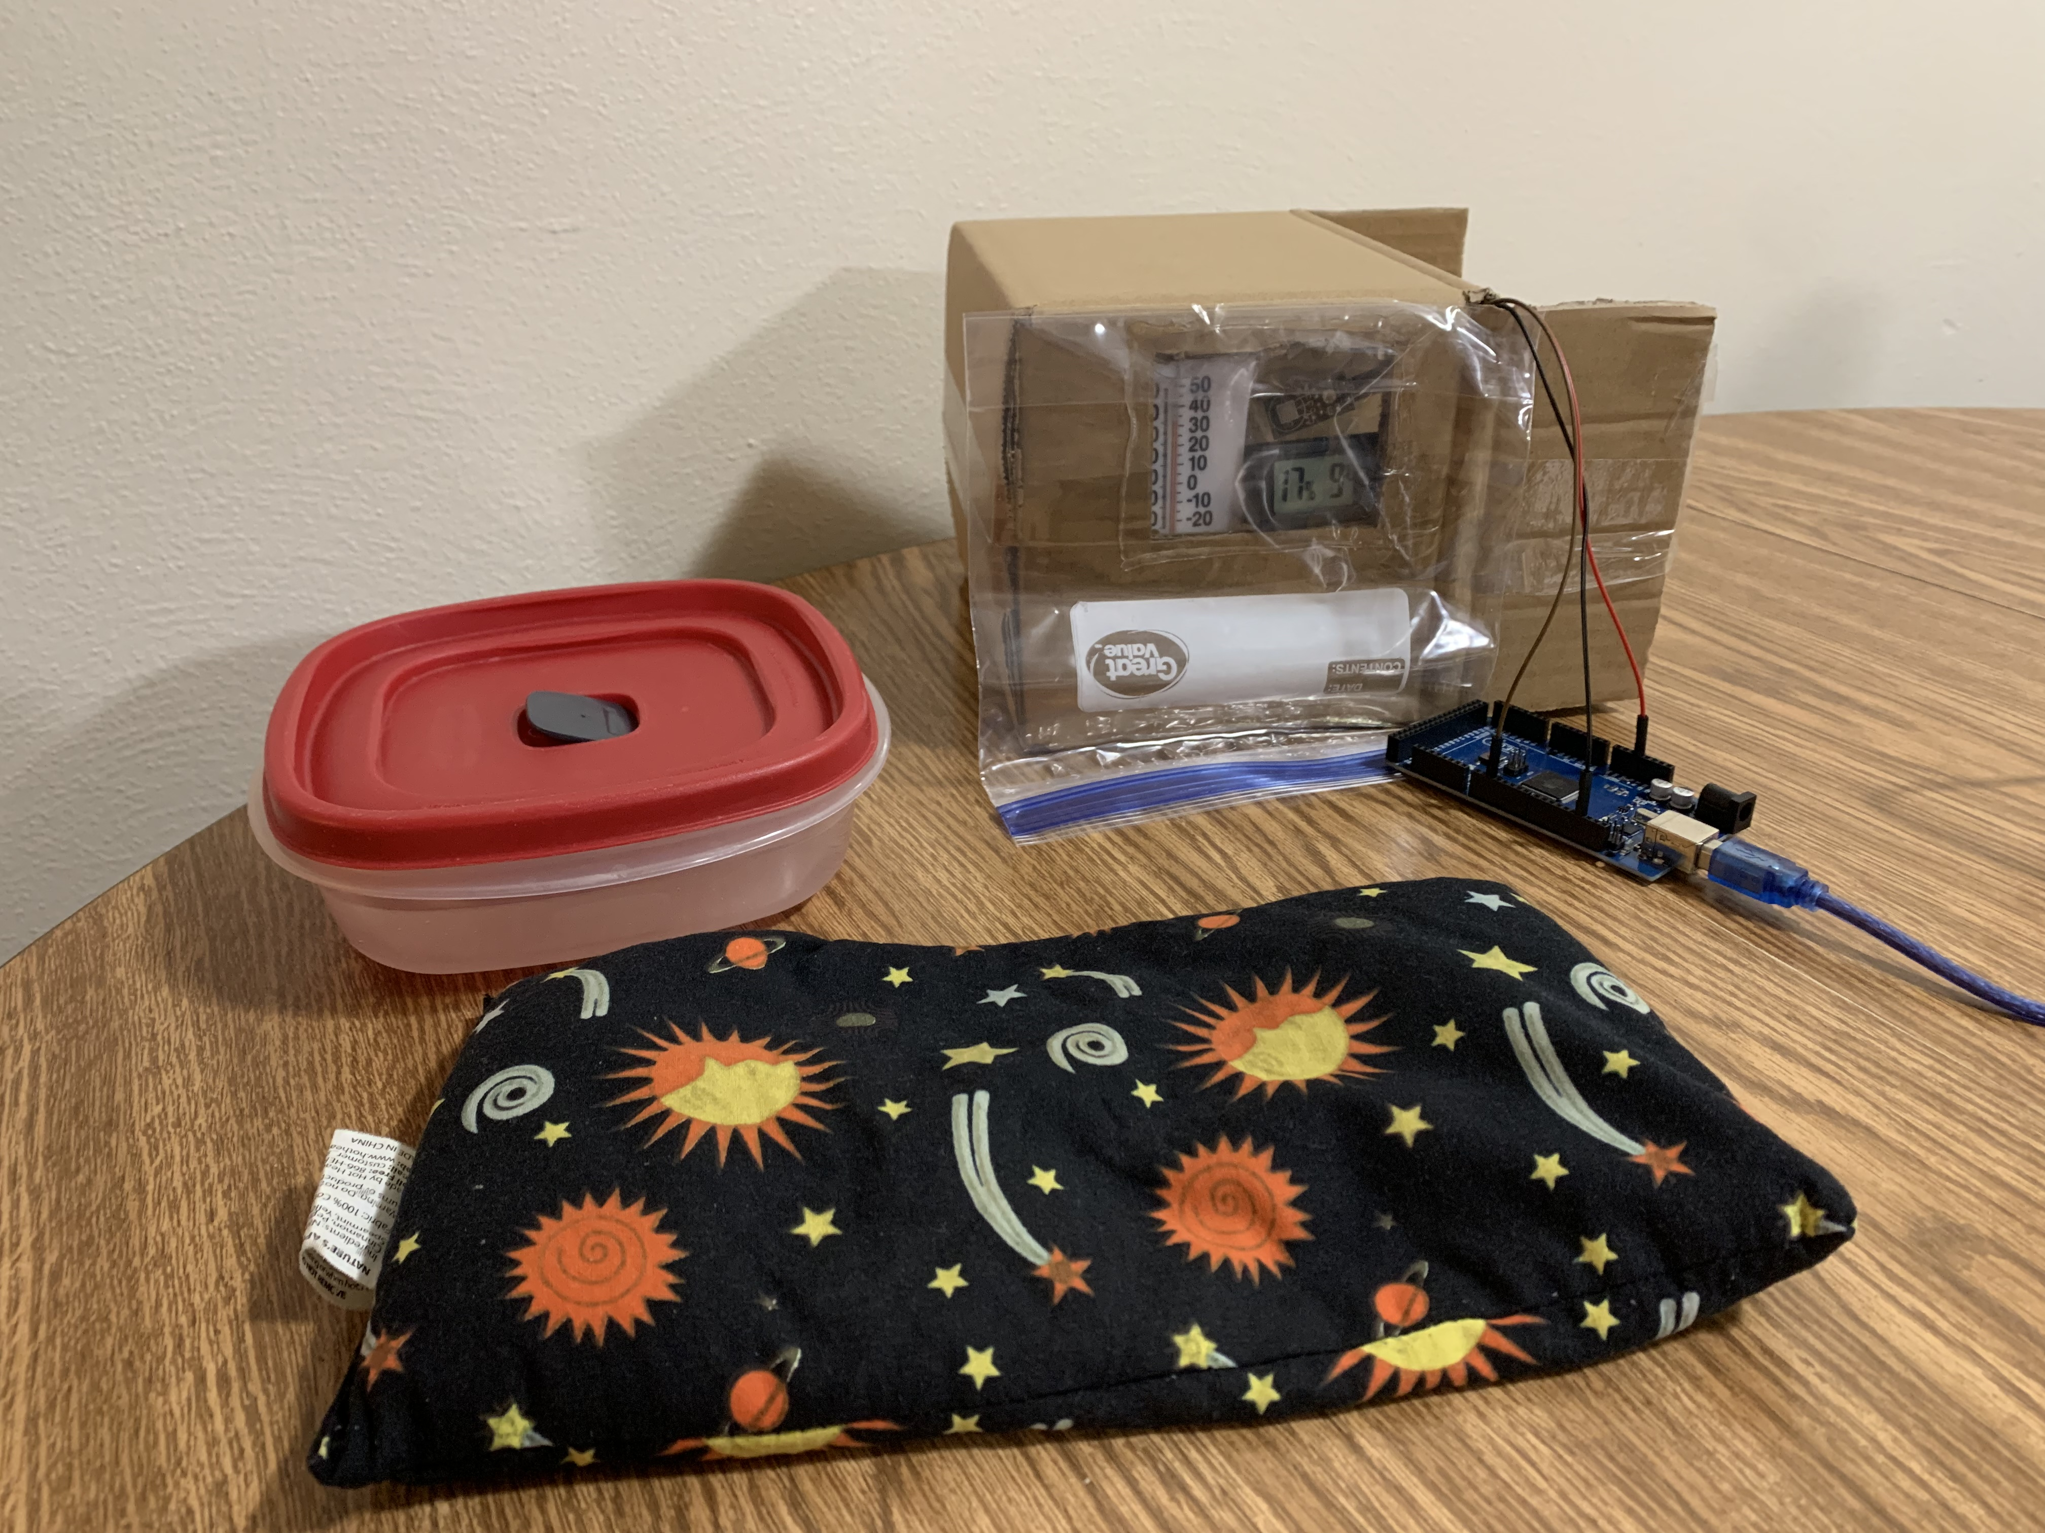
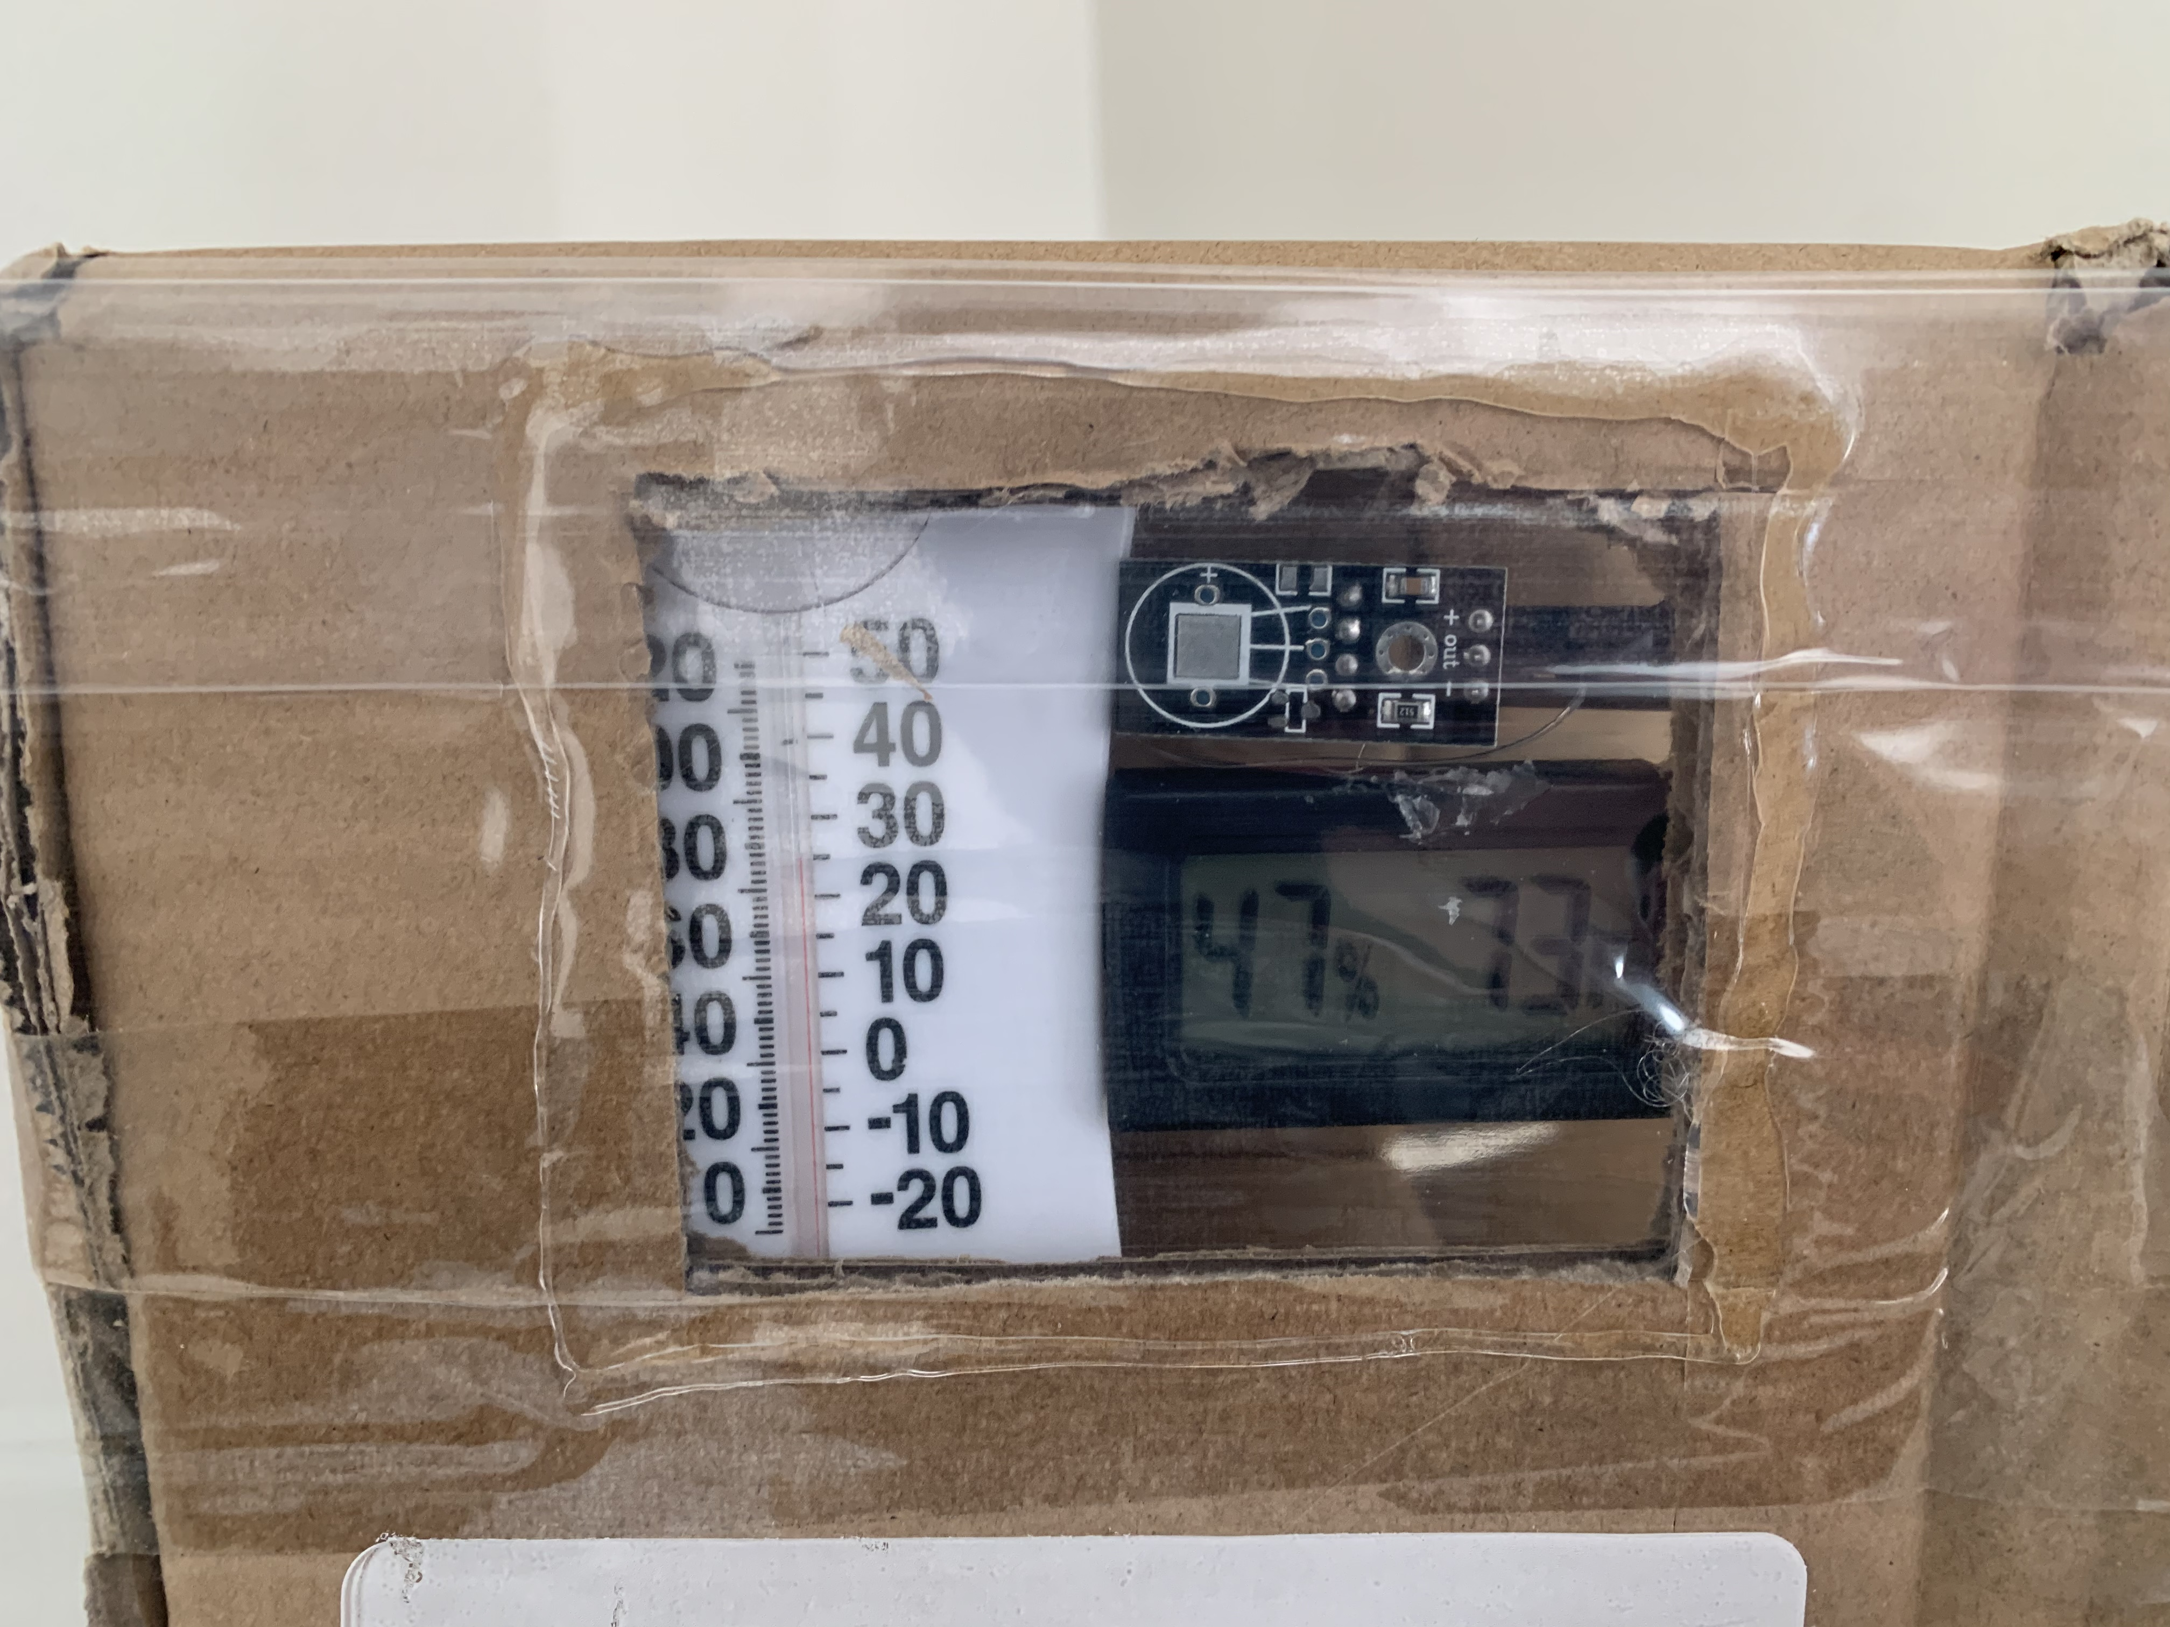
Testing Characteristics
Cardboard box was used as a control volume
Hygrometer and thermometer were verified using ground truths of dew point condensation and freezing point
Analog thermometer, Hygrometer, and DHT11 were placed inside the box
Heating pack or sealed container of hot water used to increase heat and humidity
Box was placed in freezer to obtain temperatures below 0 C
Data recorded throughout intended ranges of DHT11

Slide 6
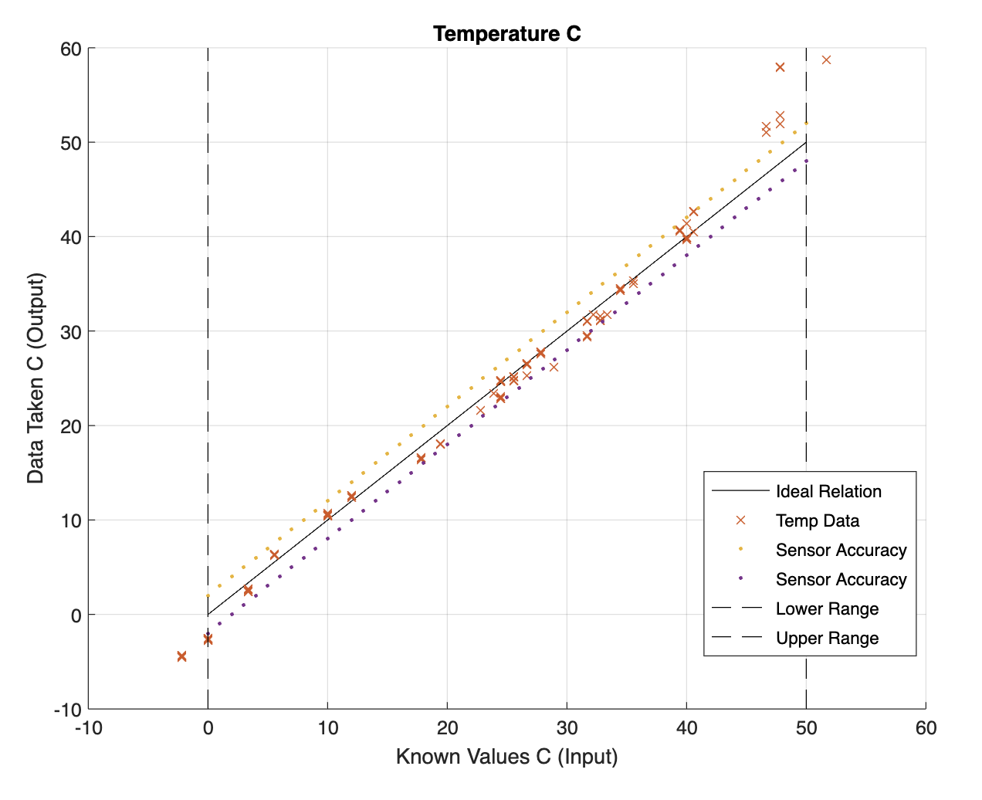
Temperature: The Center Line shows an ideal relationship between the input and output The most Accurate Range is about 5-45 C.

Slide 7
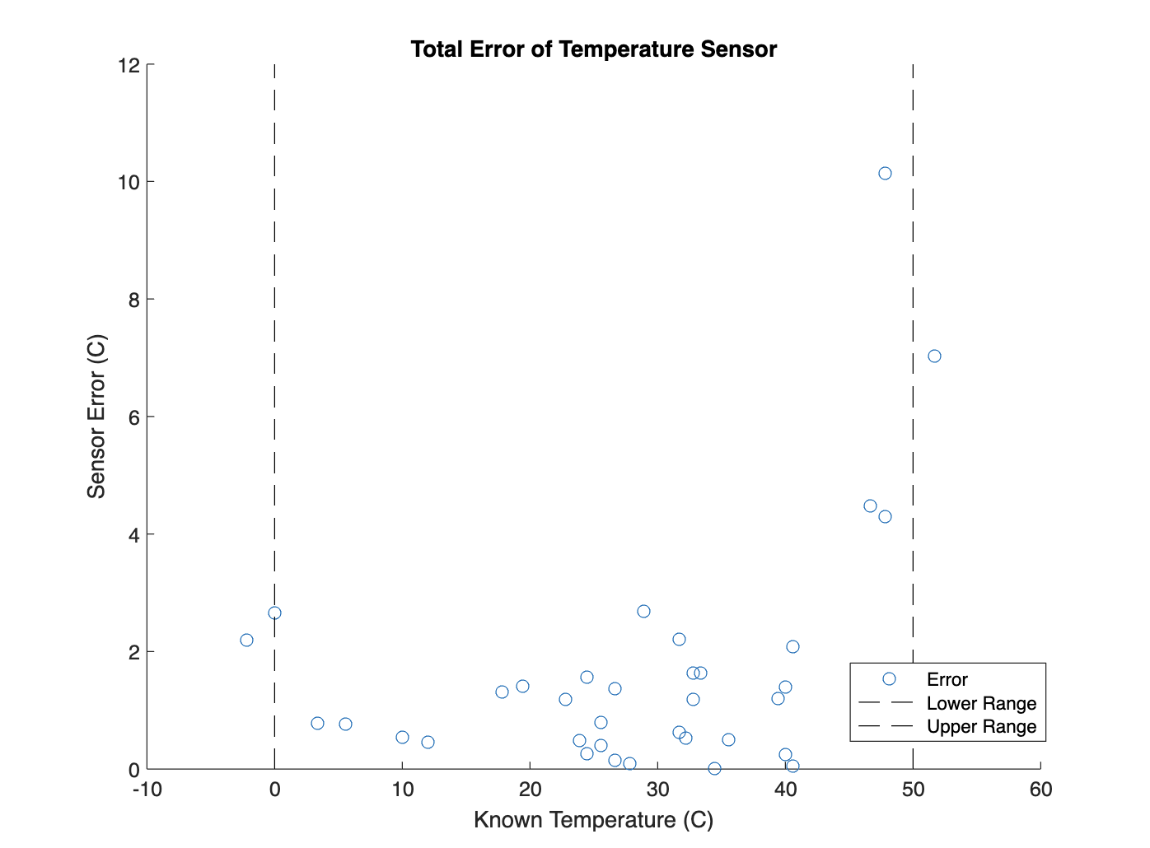
Error VS Range Visualization
The Temperature Data was Found to be somewhat Accurate
often Less accurate than Manufacturer specifications (Within 3-4 C of Real Temperature). As the Data approaches the Low and High Ranges, The sensor Error Becomes Larger And Readings are less consistent.

Slide 8
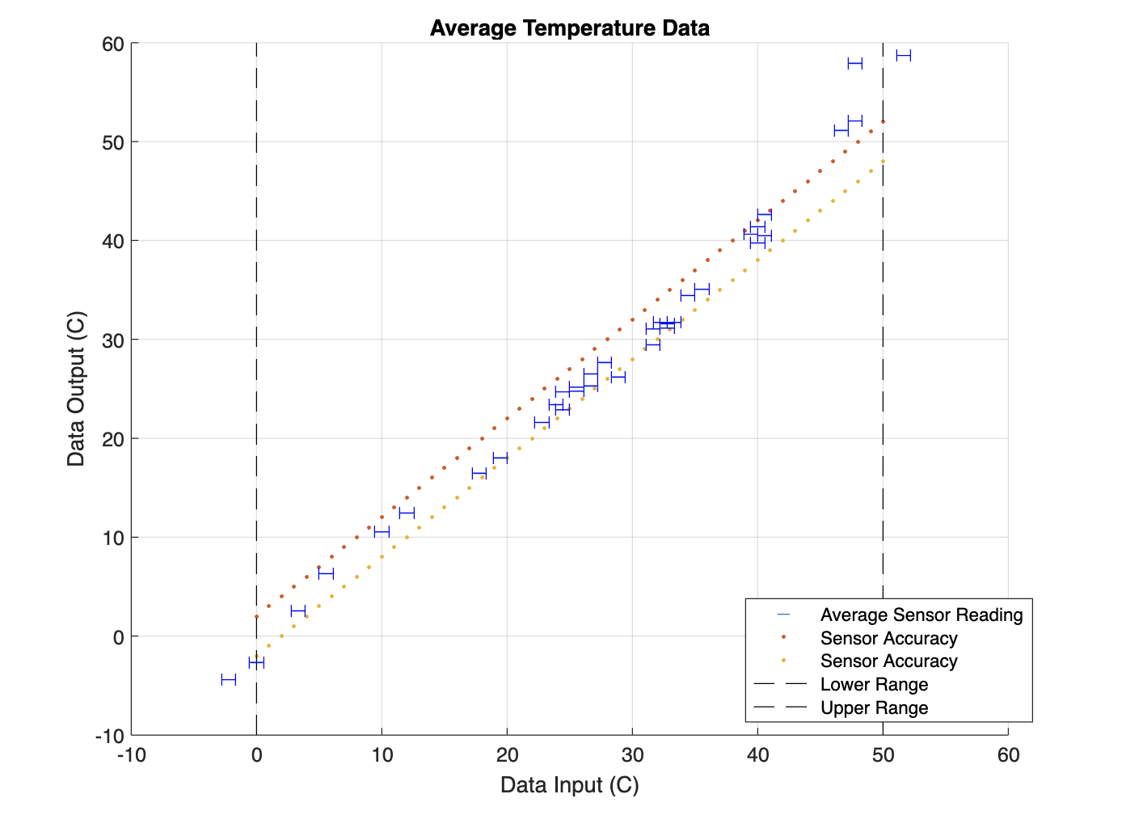
Temperature: This plot utilizes error bars to account for measurement uncertainties (Resolution) of the Reference sensors. Taking Data Sets at tHe same temperature shows Repeatability was not always within 1 C. Measurements Sometimes Varied by 3-4 C.

Slide 9
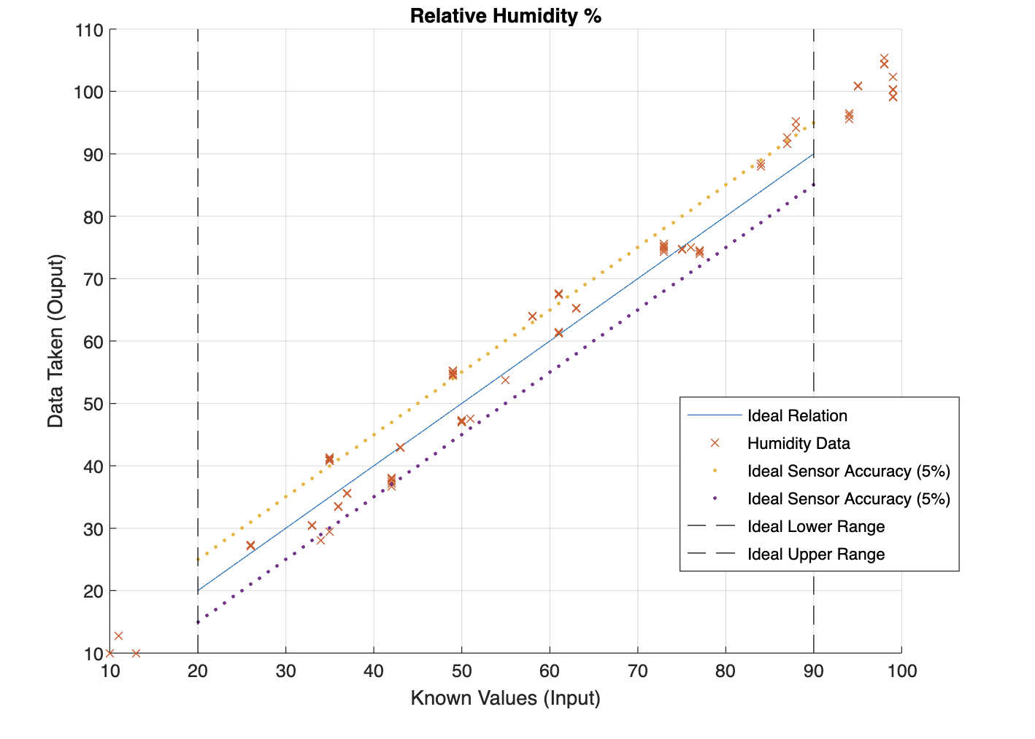
Relative Humidity: The Center Line shows an ideal relationship between the input and output The Accuracy is low and often outside of intended range

Slide 10
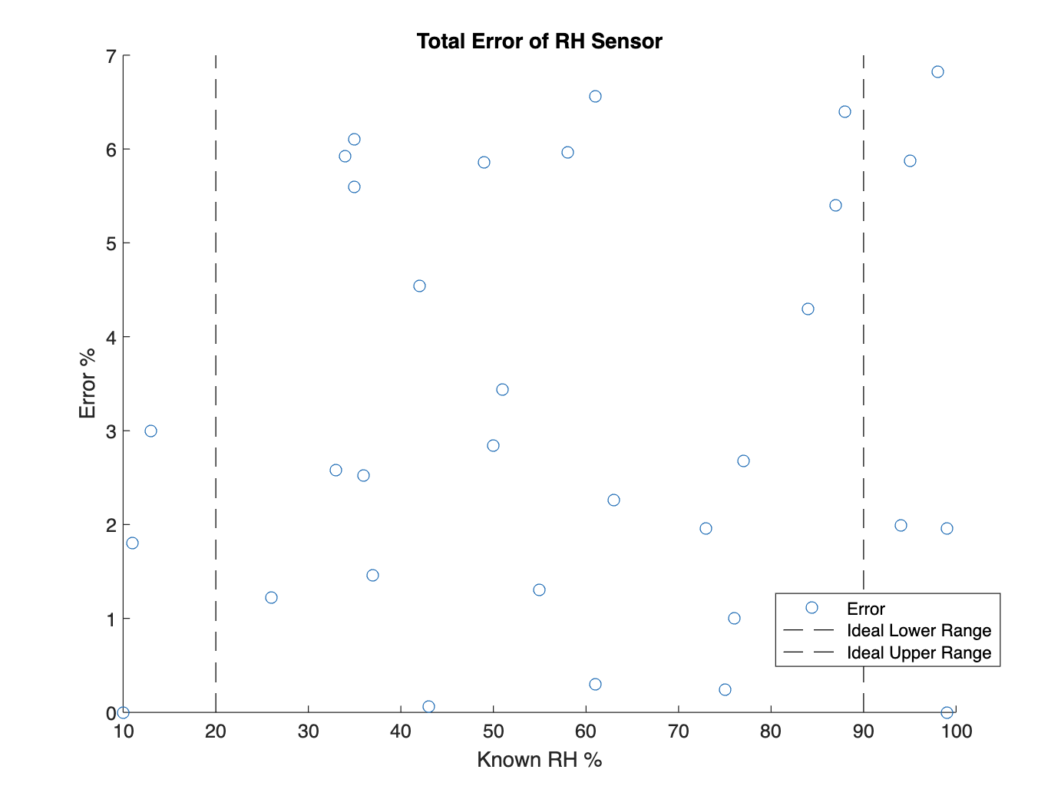
Error VS Range Visualization
The Humidity Data was Found to be Less Accurate than the temperature data (Within 6-7 % of Real Humidity). As the Data approaches the Low and High Ranges, The sensor Accuracy does not vary much.
The sensor Readings are sporadic and do not seem to Change significantly outside of intended range.

Slide 11
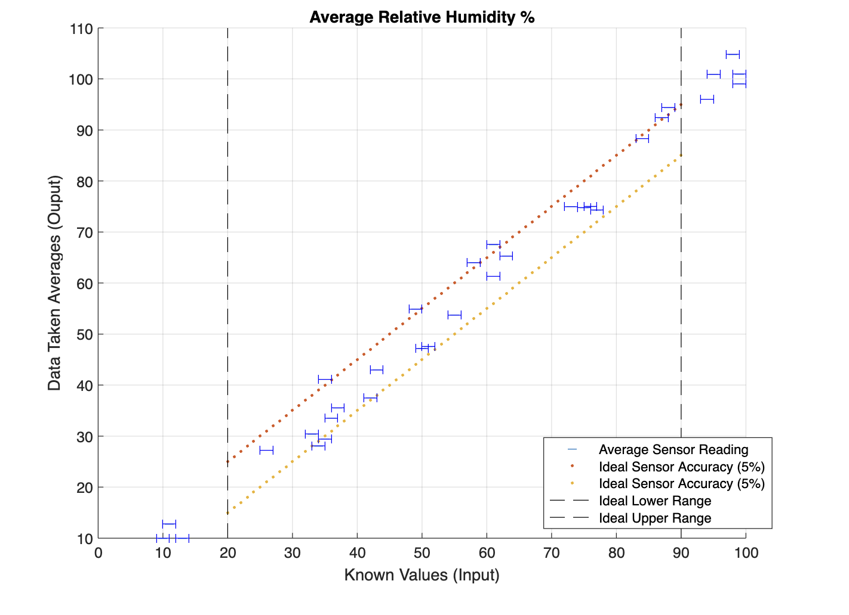
Relative Humidity: Taking Different Sets of Data at Similar temps shows Repeatability Rarely within 1%. Measurements Often Varied by 5-6 %

Slide 12
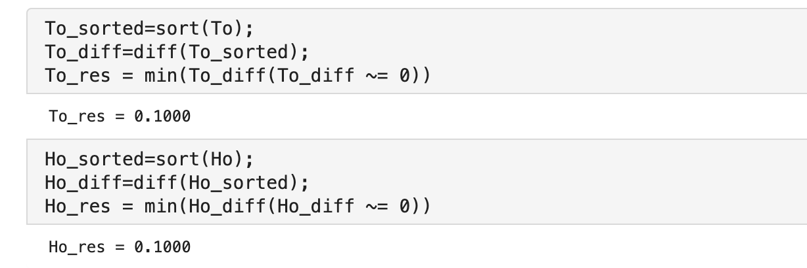
Resolution
The DHT11 can read data with a resolution of 0.1 C and 0.1 % RH

Slide 13
Summary
The DHT11 is a sensor that can be used for applications where accurate measurements are not Imperative.
The temperature range and accuracy is slightly worse than specified in the manufacturer’s data sheet, while the relative humidity data was less reliable and measurements were more sporadic, though only slightly less reliable than the Datasheet’s specifications.

